Slide 1
Photo Album
ICDS Project Chattisgarh

Slide 2
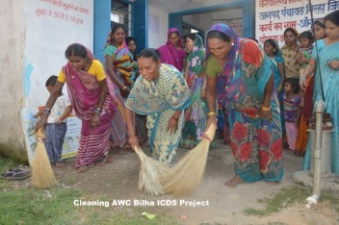
Cleaning AWC Bilha ICDS Project

Slide 3
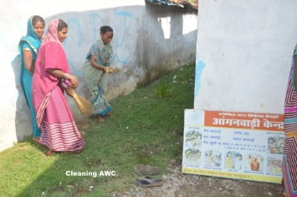
Cleaning AWC Bilha ICDS Project

Slide 4
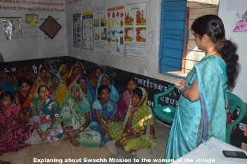
Explaining about Swachh Mission to women of the village

Slide 5
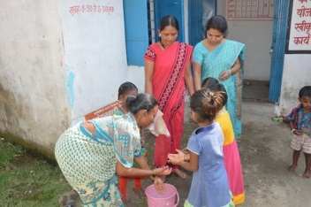
Cleaning hands

Slide 6
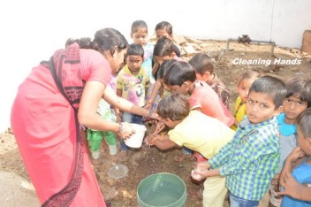
Cleaning hands

Slide 7
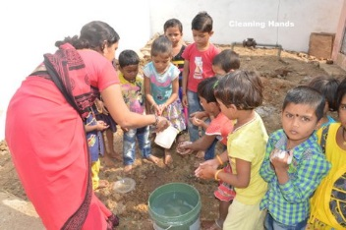
Cleaning hands

Slide 8
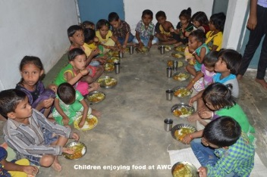
Children enjoying their food at Anganwadi center

Slide 9
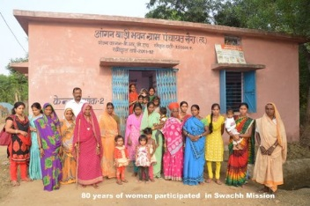
80 years of women participated in Swachh Mission

